Slide 1

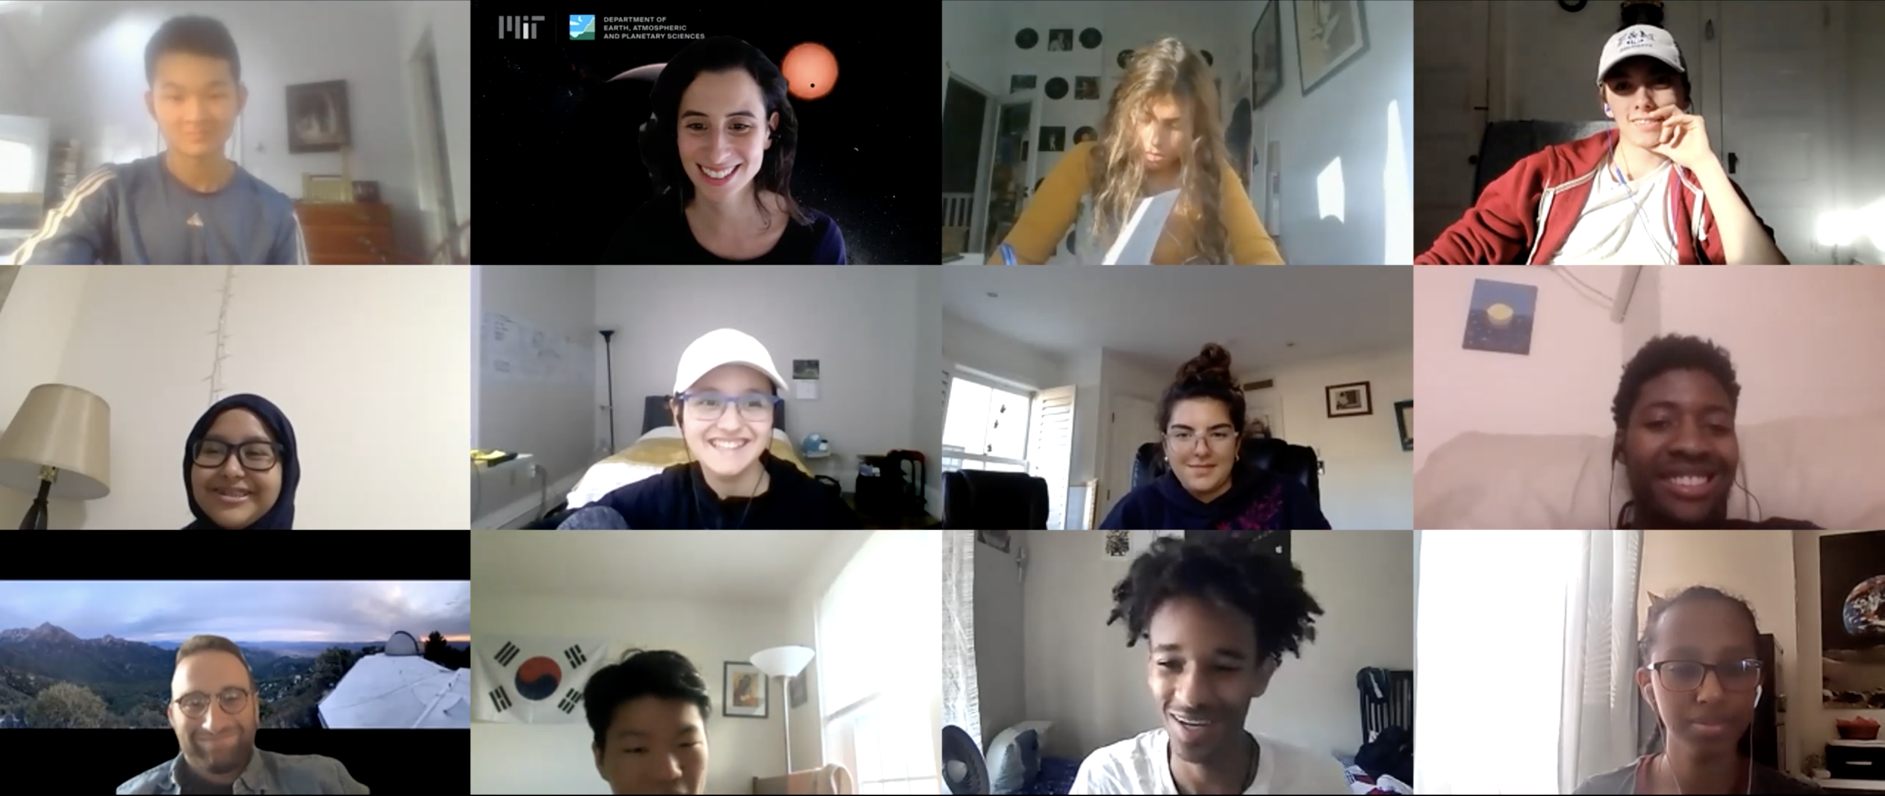
SRMP Symposium 2021
May 21, 2021 from 4:00-6:00 pm
Let our incredible students tell you about their amazing research projects!
The MIT Museum and Harvard invite you to the 2021 Harvard-MIT Science Research Mentoring Program Symposium
Event Details:
Come listen as our 2020-2021 SRMP high-school students describe their research project and experience in the program.
Everyone is invited and event is free registration is required!
The event will be hosted as a virtual Zoom webinar
Register for symposium here
For more information visit: https://projects.iq.harvard.edu/shrimp
Questions? Please email:
Dr. Clara Sousa-Silva (clara.sousa-silva@cfa.harvard.edu)
Mr. Daniel Yahalomi (daniel.yahalomi@columbia.edu)

